Slide 1

May 2022
Automated Proctoring
Exam Overview

Slide 2
Step 1: Sign in to Examity
Step 2: Start Exam
Step 3: Systems Check
Step 4: Install Extension and Grant Permissions
Step 5: Authentication
Step 6: Review Instructions
Step 7: User Agreement
Step 8: Screen Launch
Step 9: Begin Exam/Examity Sidebar
Step 10: End Proctoring Session
Step 11: Survey (Optional)

Slide 3
Automated Proctoring Exam Overview
Sign in to
Examity
2
4
6
1
Click
Start Exam
Systems
Check
Install Examity Extension and Grant Permissions
Authentication
Review
Instructions
3
5
User
Agreement
8
10
11
7
Screen
Launch
Begin Exam/
Examity Sidebar
End Proctoring Session
Survey
(Optional)
9

Slide 4
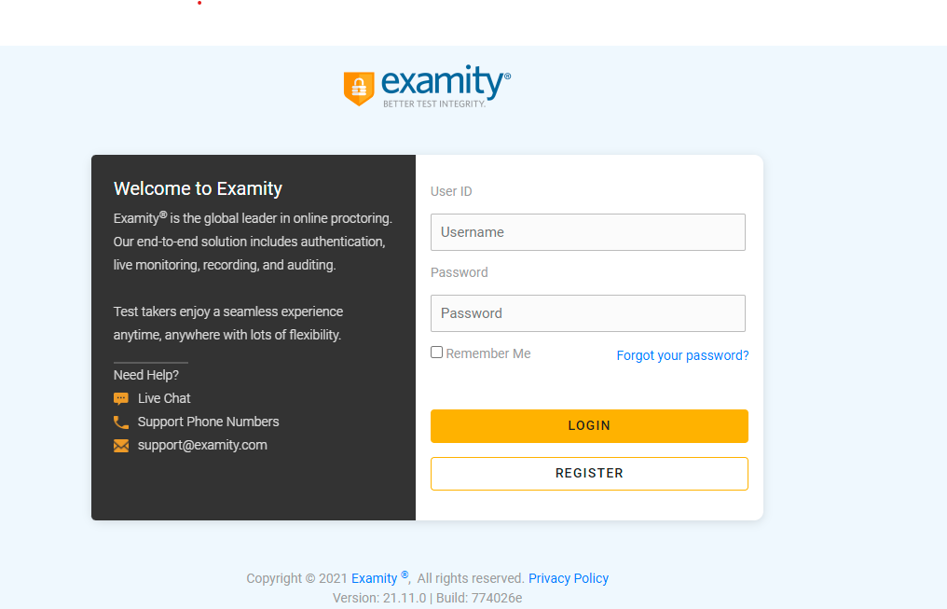
Automated Proctoring Exam Overview
Sign in to Examity
1
The test-taker will need to sign in to Examity, if they have not already done so, using the link provided in the welcome email: https://on.examity.com/V5/x/217

Slide 5
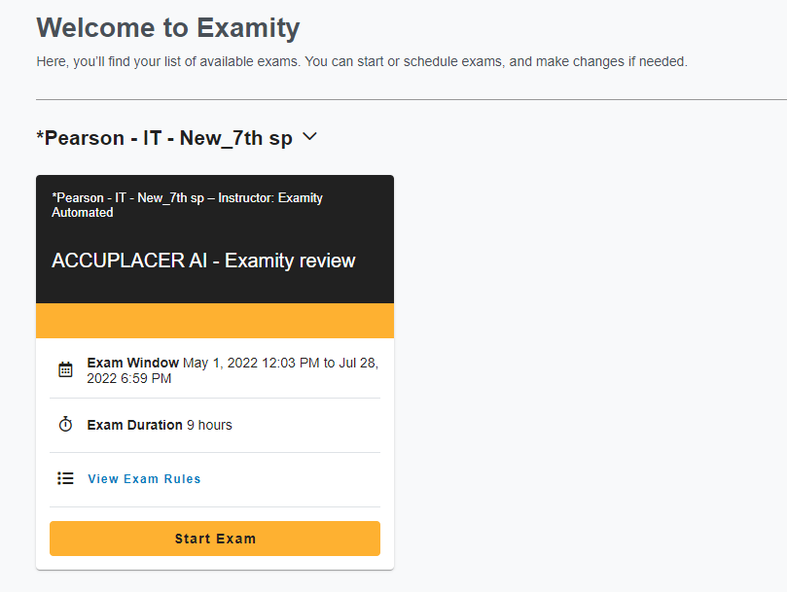
Automated Proctoring Exam Overview
Start Exam
2
Once logged in, the test-taker will see their exam card on their dashboard.
The automated exam workflow does not require the test-taker to schedule their exam.
The test-taker can click Start Exam and start their exam session immediately.

Slide 6
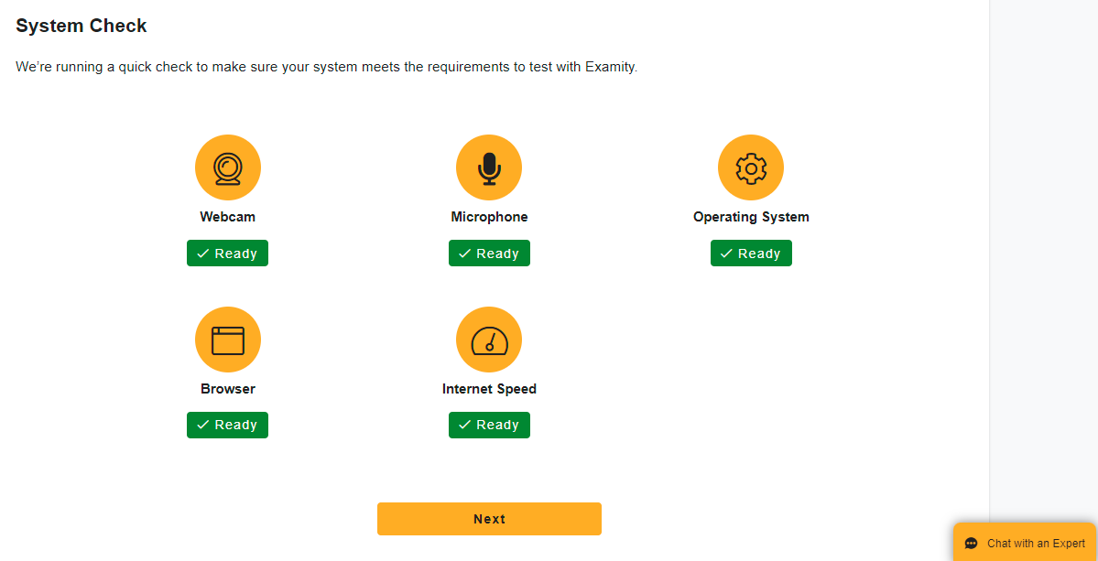
Automated Proctoring Exam Overview
System Check
3
The test-taker will be prompted to complete the systems check and then press Next.

Slide 7
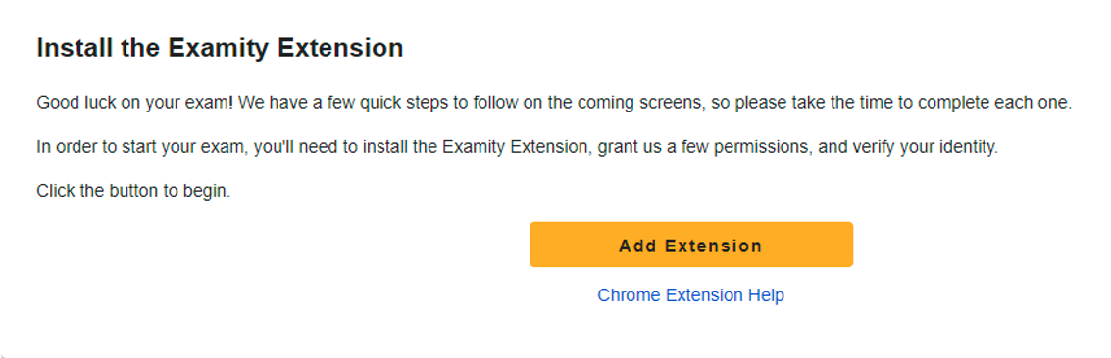
Automated Proctoring Exam Overview
Install the Examity Extension
4
Next, the test-taker will need to install the Examity extension by selecting Add Extension.

Slide 8
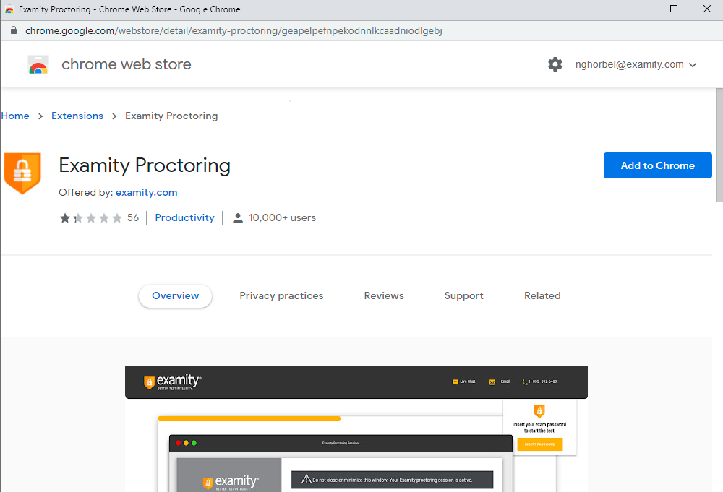
Automated Proctoring Exam Overview
4
Install the Examity Extension
Add to Chrome
A pop-up window will appear. The test-taker will need to click on Add to Chrome.

Slide 9
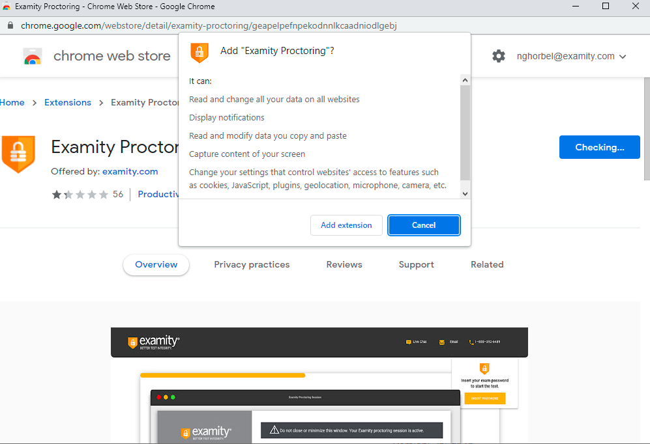
Automated Proctoring Exam Overview
4
Install the Examity Extension
Add Extension
Then, the test-taker can click Add Extension to complete the extension setup process.
Once added, the test-taker will continue to the authentication process.

Slide 10
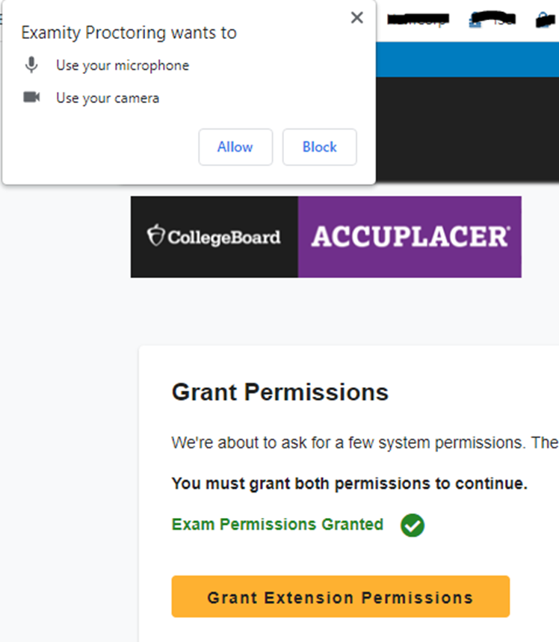
Automated Proctoring Exam Overview
4
Grant Permissions
Allow webcam and microphone access
The test-taker will now be prompted to grant permission to access their webcam and microphone. They will click “Allow” when prompted.

Slide 11
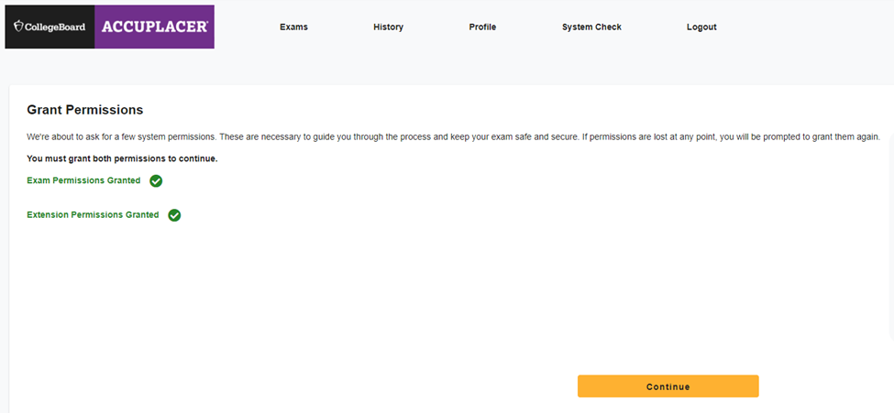
Automated Proctoring Exam Overview
4
Grant Permissions
Click continue
Once permissions have been granted, the test-taker will click “continue” to proceed through the authentication process.

Slide 12
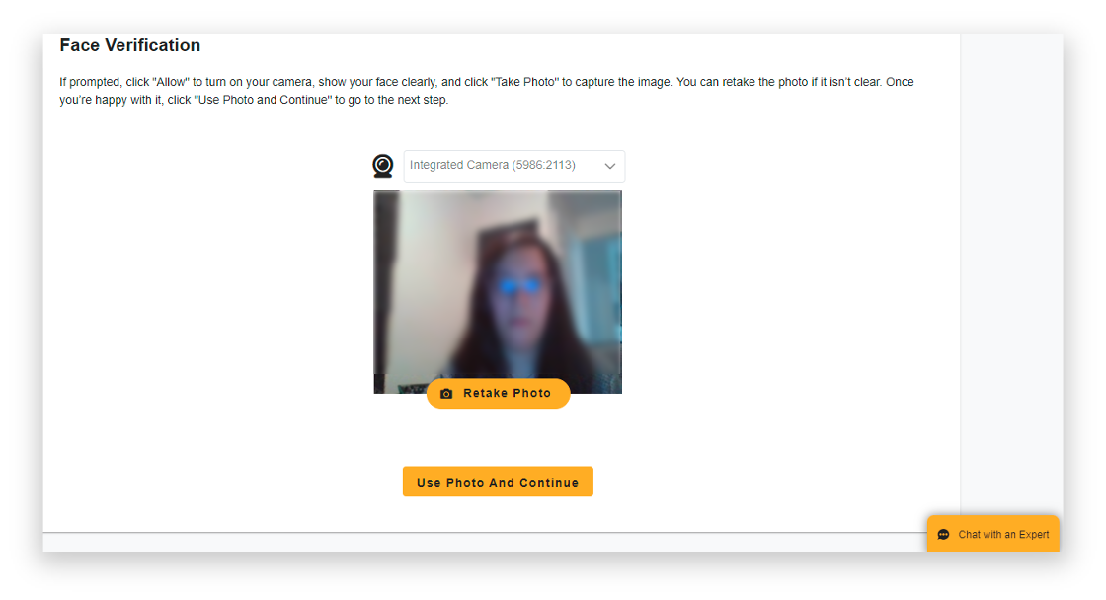
Automated Proctoring Exam Overview
5
Authentication
Face
Verification
The first part of the authentication process is the face verification. The test-taker will need to take a photo – and retake if necessary – and then click Use Photo and Continue.

Slide 13
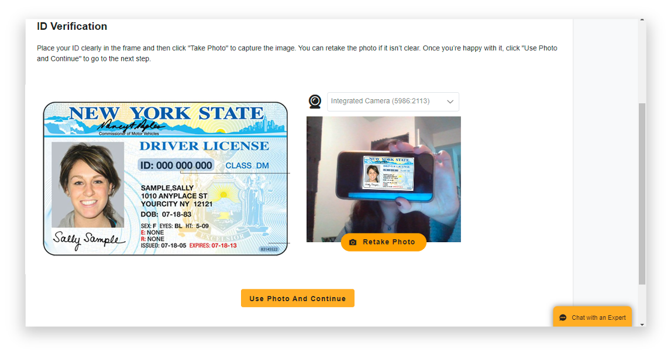
Automated Proctoring Exam Overview
5
Authentication
ID Verification
The second part of the authentication is the ID verification. The test-taker will need to take a live picture of their ID and then select Use Photo and Continue.

Slide 14
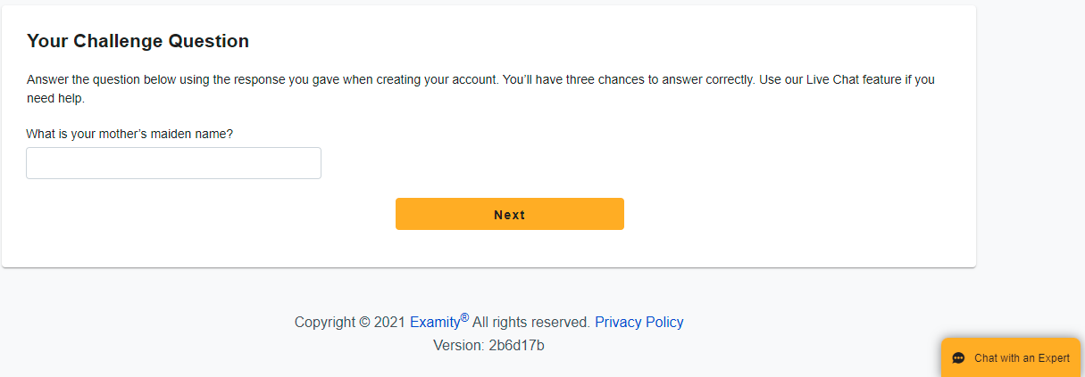
Automated Proctoring Exam Overview
5
Authentication
Challenge
Question
The final step of the authentication process is the challenge questions section. The test-taker will be asked one of the three challenge questions, enter in the answer, and then click Next.

Slide 15
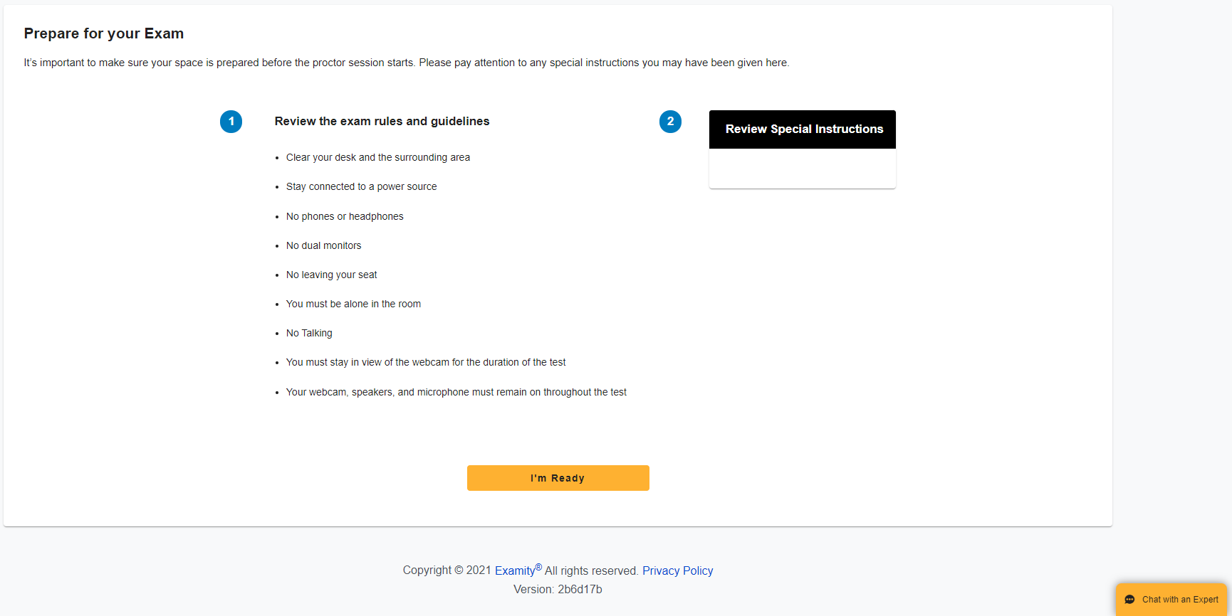
Automated Proctoring Exam Overview
Review
Instructions
6
The test-taker will be able to review a list of the Examity standard rules, along with any additional and special instructions if applicable.

Slide 16
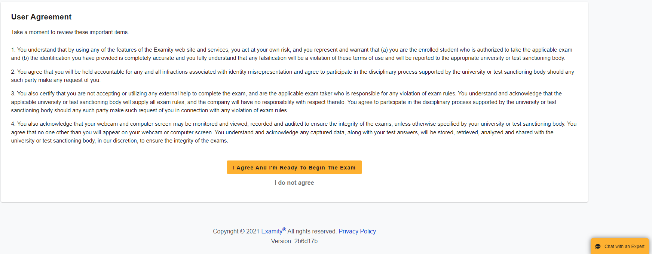
Automated Proctoring Exam Overview
User Agreement
7
The test-taker will also need to review the User agreements and then click I Agree And I’m Ready To Begin The Exam. If the test-taker chooses I do not agree, then they will NOT be able to take the exam.

Slide 17
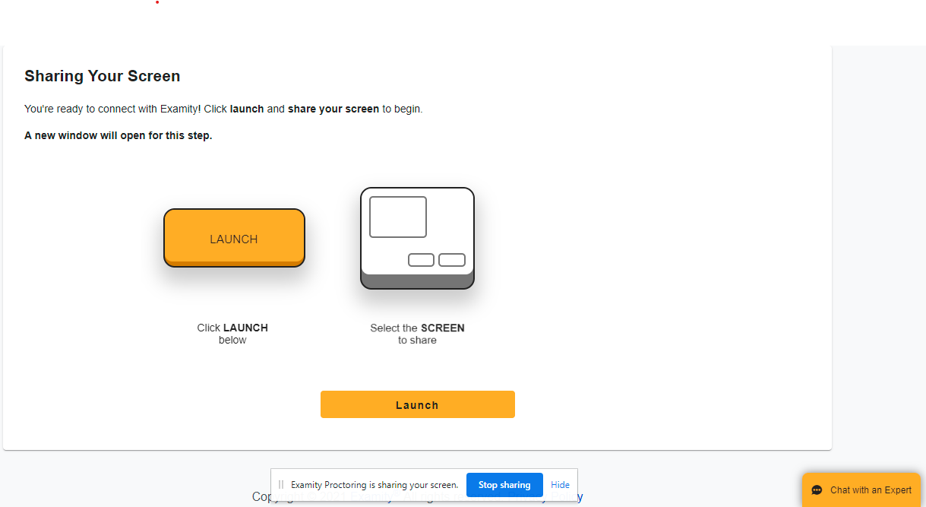
Automated Proctoring Exam Overview
Screen Launch
8
Now, the test-taker will be prompted to launch the screen share by clicking Launch.

Slide 18
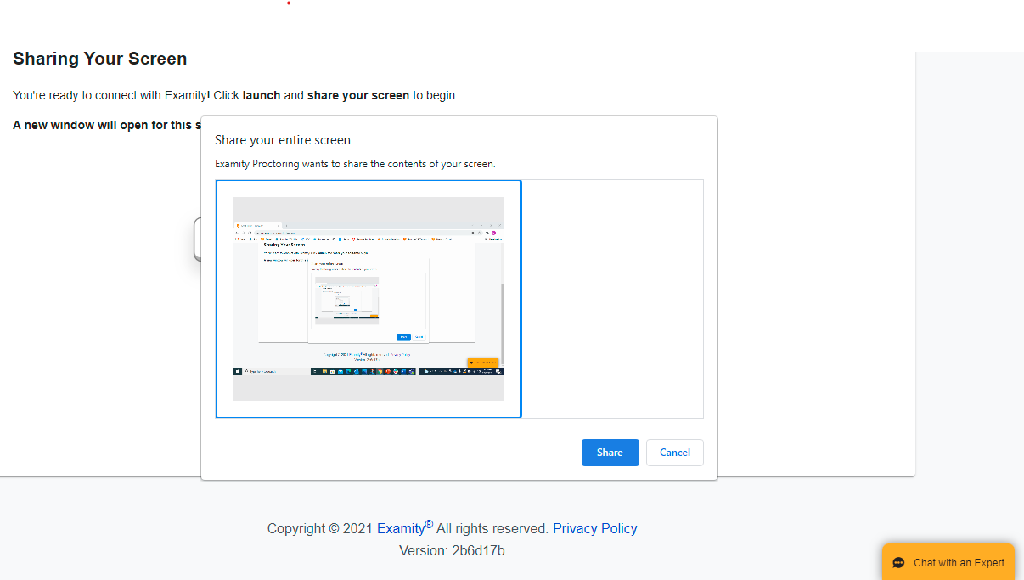
Automated Proctoring Exam Overview
Screen Launch
8
Then, they will need to select their entire screen and click Share.

Slide 19
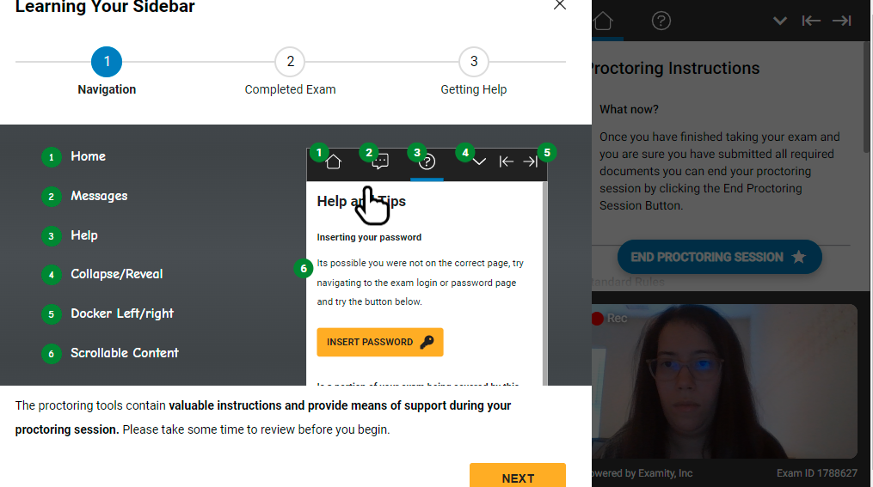
Automated Proctoring Exam Overview
Begin Exam/
Examity Sidebar
9
The test-taker is now brought to the exam page. They will see a sidebar appear to the right of the screen, followed by a Learning Your Sidebar pop-up. The test-taker will need to click through the prompts showcasing how to utilize this feature for the duration of the exam.

Slide 20
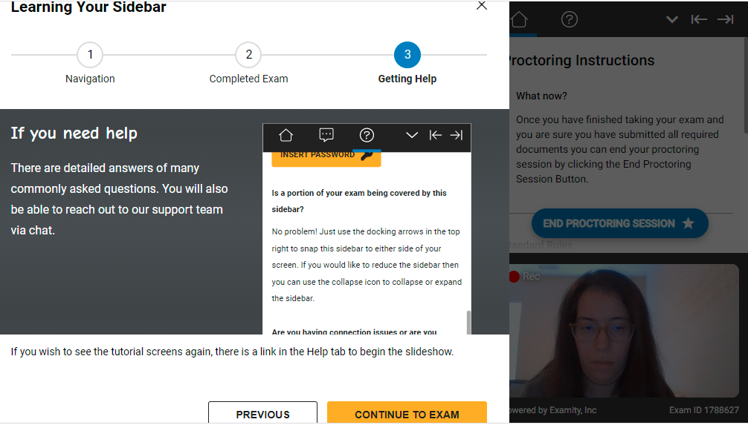
Automated Proctoring Exam Overview
Begin Exam/
Examity Sidebar
9
The test-taker will need to click through all steps of the sidebar information pop-up
and then press Continue To Exam.

Slide 21
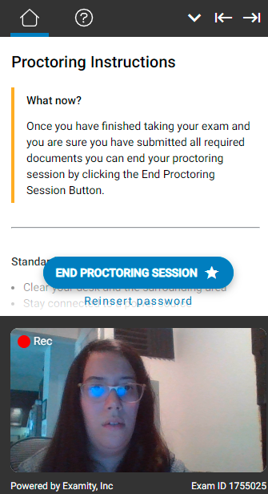
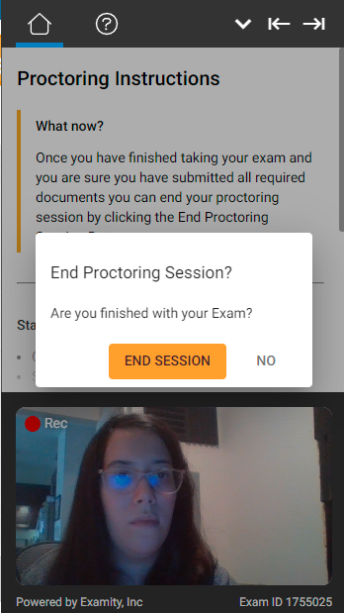
Automated Proctoring Exam Overview
End Proctoring Session
10
Once the test-taker completes the exam, they will need to officially end the session
with Examity by clicking End Proctoring Session, then choose End [the] Session.

Slide 22
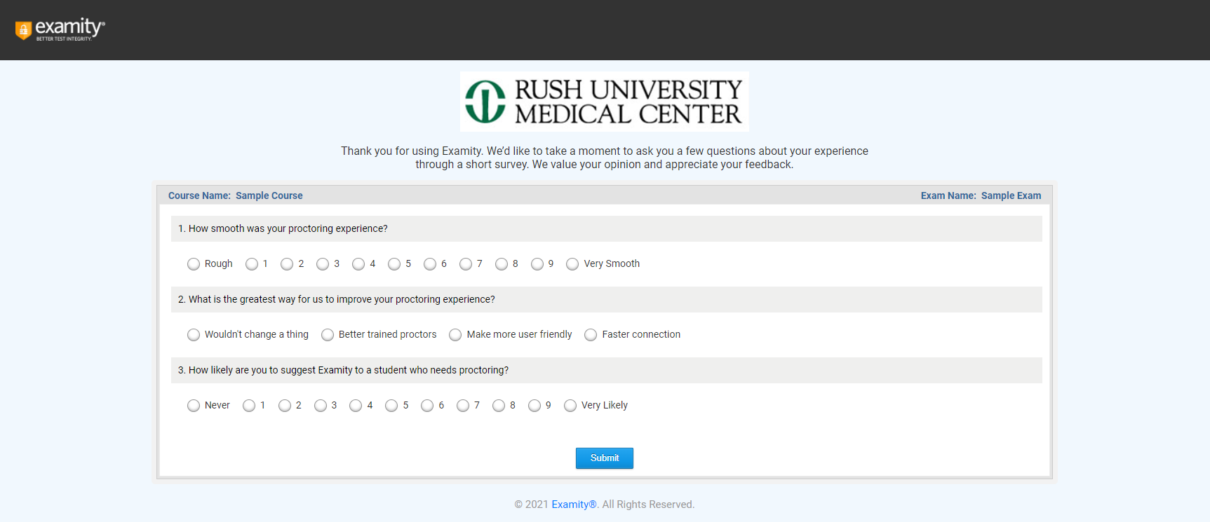

Automated Proctoring Exam Overview
Survey
(Optional)
11
The exam screen automatically closes after the session ends and the test-taker will now
see a survey. This survey is optional and provides Examity with feedback on the exam experience.

